Slide 1


SOFTWARE ENGINEERING (Week-7)
Usama Musharaf
Lecturer (Department of Computer Science)
FAST-NUCES Peshawar

Slide 2
Contents of week # 7
Software Quality Attributes
Performance
Scalability

Slide 3
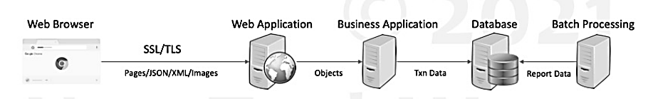
Sample System

Slide 4
Performance

Slide 5
Performance
Measure of how fast or responsive a system is under
A given workload
Backend data
Request Volume
A given hardware
Kind
capacity

Slide 6
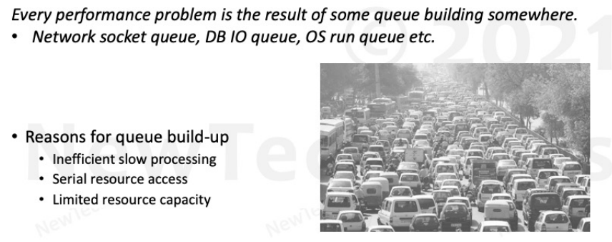
Performance Problems
How to spot a performance problem? How does it look like?

Slide 7
Performance Principles
Efficiency
Efficient Resource Utilization
IO- Network, Memory, Disk
CPU
Efficient Logic
Algorithms
DB Queries
Efficient Data Storage
Data Structures
DB Schema
Caching
Concurrency
Hardware
Software
Queuing
Coherence
Capacity

Slide 8
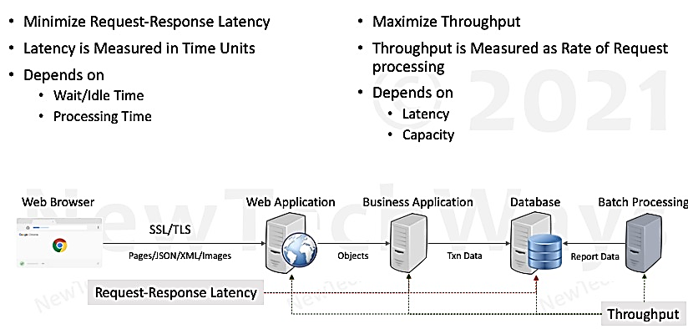
Performance Objectives

Slide 9
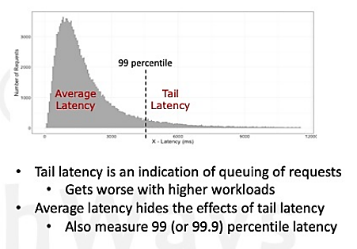
Performance Measurement Metrics
Latency
Affects– User Experience
Desired– As low as possible
Throughput
Affects– Number of users that can be supported
Desired– Greater than the request rate
Errors
Affects– Functional Correctness
Desired– None
Resource Saturation
Affects– Hardware Capacity Required
Desired– Efficient utilization of all system resources.

Slide 10
Serial Request Latency

Slide 11
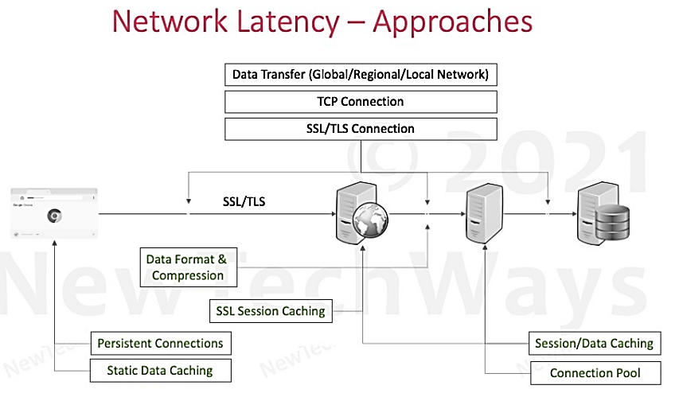

Slide 12
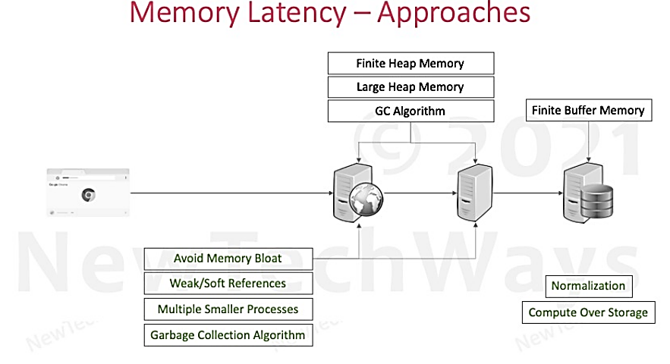

Slide 13
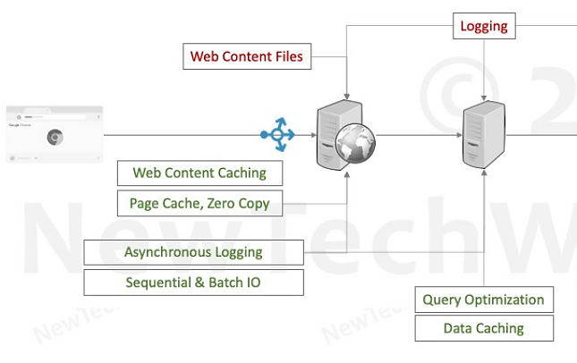
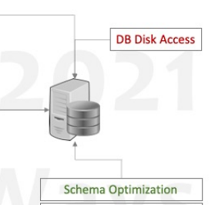
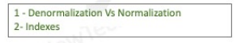
Disk Latency - Approaches

Slide 14
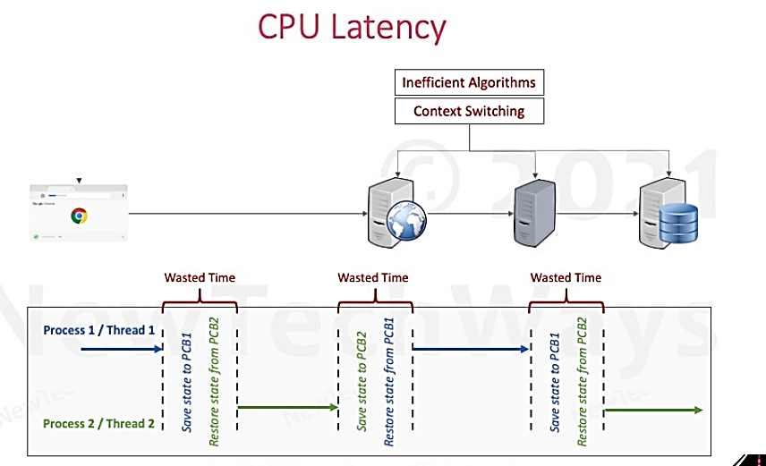

Slide 15
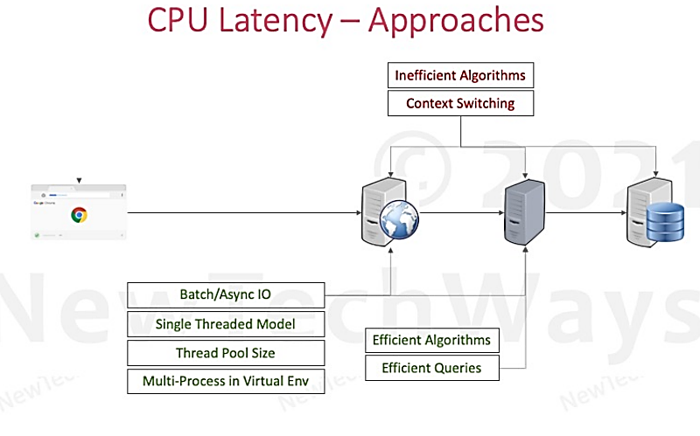

Slide 16
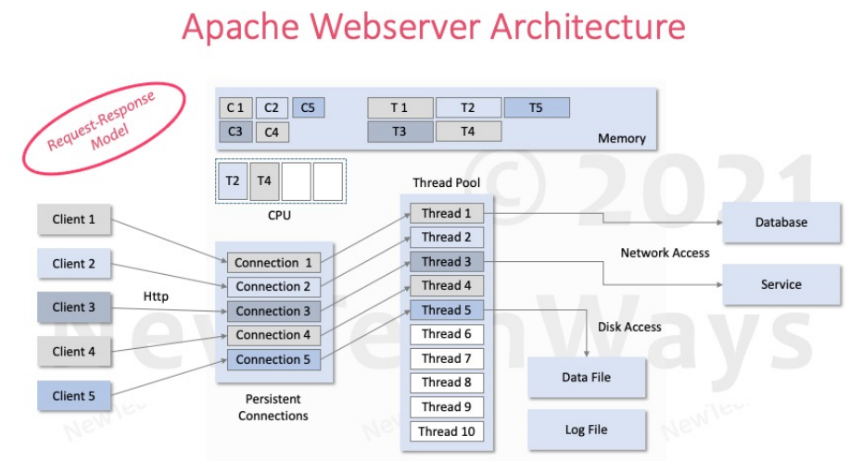

Slide 17
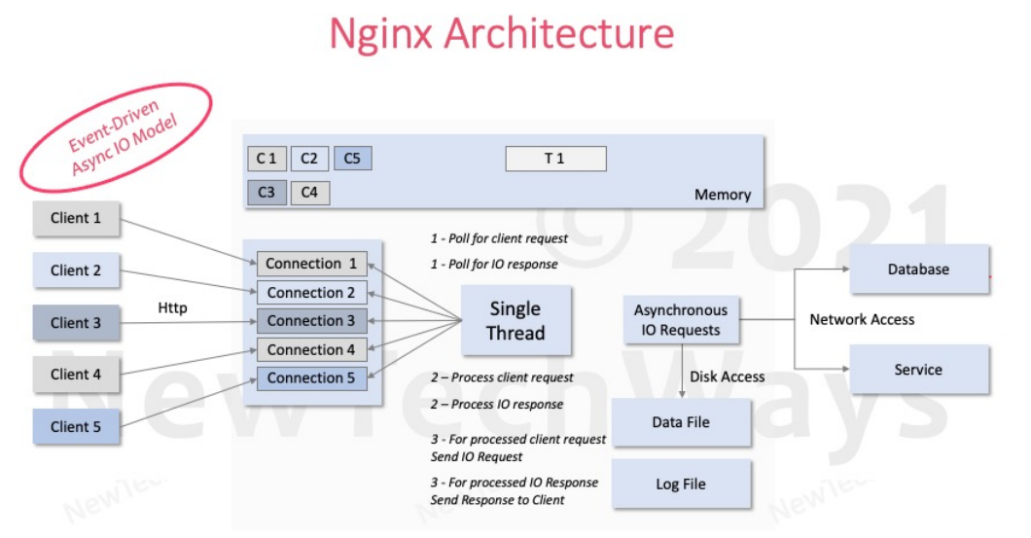

Slide 18
Parallel Request (Concurrency)

Slide 19
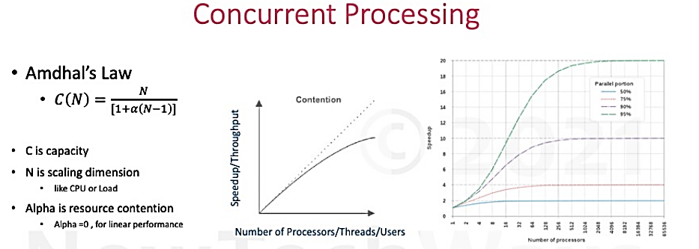
C(N) = theoretical speed
Parallel + Serial

Slide 20
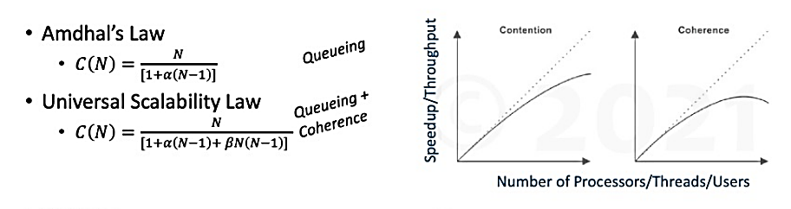
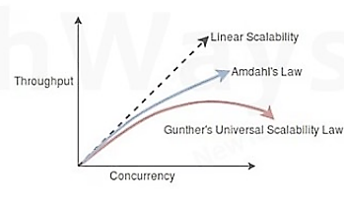
Concurrent Processing
C is capacity
N is scaling dimension like CPU or load
Alpha represents resource contention
Beta represents coherence delay
Linear performance when alpha and beta are zero

Slide 21
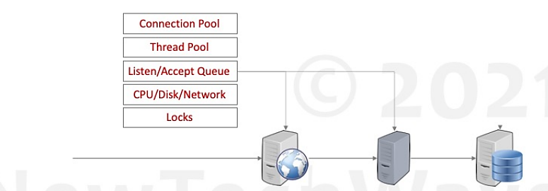

Contention

Slide 22
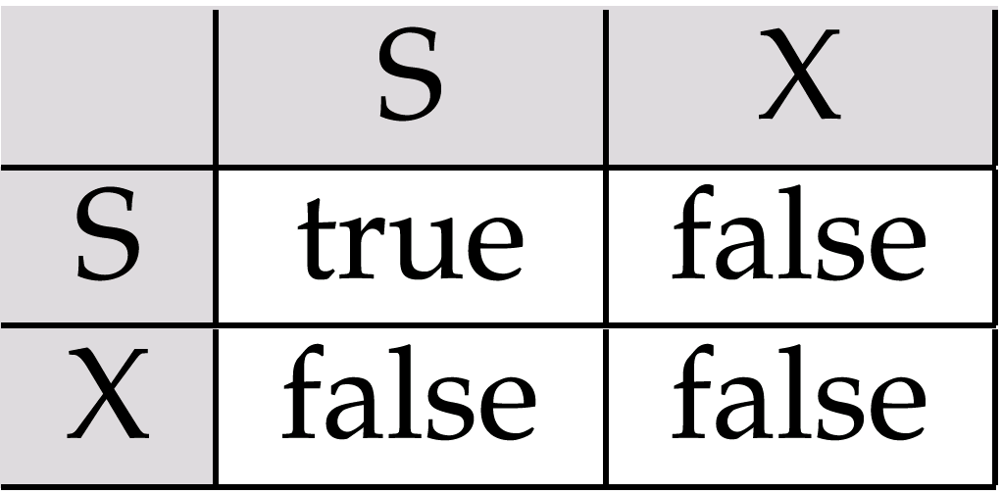
Locking Compatibility Matrix

Slide 23
Coherence
Suppose that two threads are working on SharedObj. If two threads run on different processors each thread may have its own local copy of sharedVariable.
If one thread modifies its value the change might not reflect in the original one in the main memory instantly. This depends on the write policy of cache. Now the other thread is not aware of the modified value which leads to data inconsistency.
“Volatile” keyword in java tells the compiler that the value of a variable must never be cached as its value may change outside of the scope of the program itself.

Slide 24
Scalability

Slide 25
Performance vs Scalability
FIXED LOAD
Performance
Low Latency
High Throughput
Concurrency
Single-Machine- Multi-Threading
Multi-Machine- Multi-Threading + Multiprocessing = Distributed Processing
VARIABLE LOAD
Scalability
High Throughput
Ability of a system to increase its throughput by adding more hardware capacity.
Both Ways: Up and Down

Slide 26
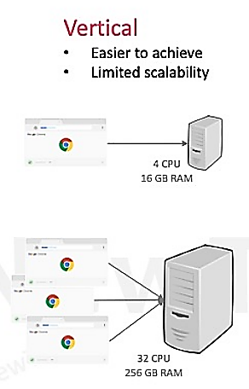
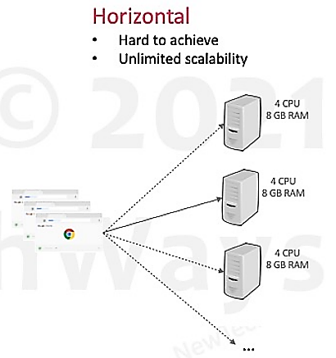
Vertical & Horizontal Scalability

Slide 27
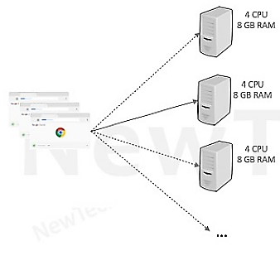
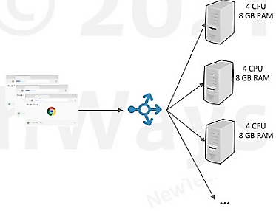
Reverse Proxy
Client needs to know only about the address of the Reverse Proxy.
Reverse proxy can also act as load balancer.

Slide 28
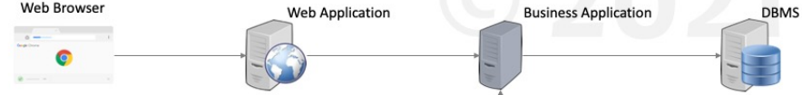
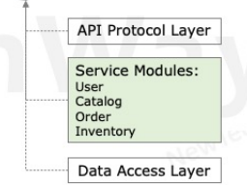
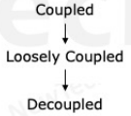
Modularity
Scalable architecture starts with Modularity
Provides the foundation for breaking an application into more specialized functions/services.

Slide 29
Horizontal Scaling Methods
Services
Replication
Stateful
Stateless
Portioning
Vertical / Functionality Portioning
Database portioning
Asynchronous Calls

Slide 30
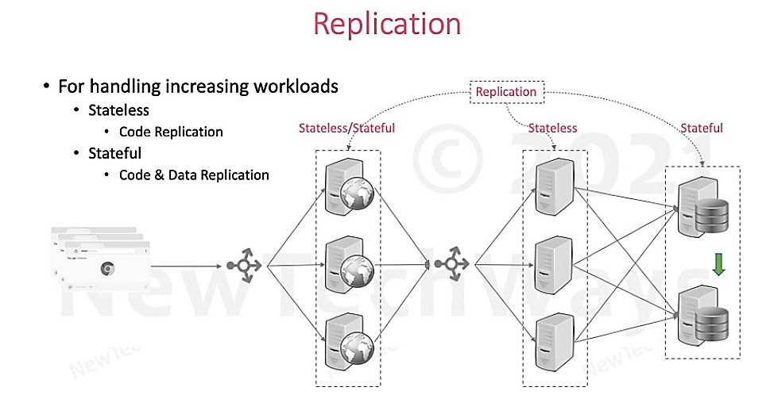

Slide 31
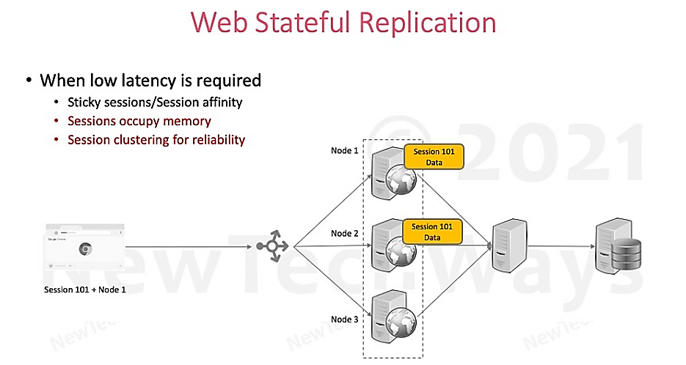

Slide 32
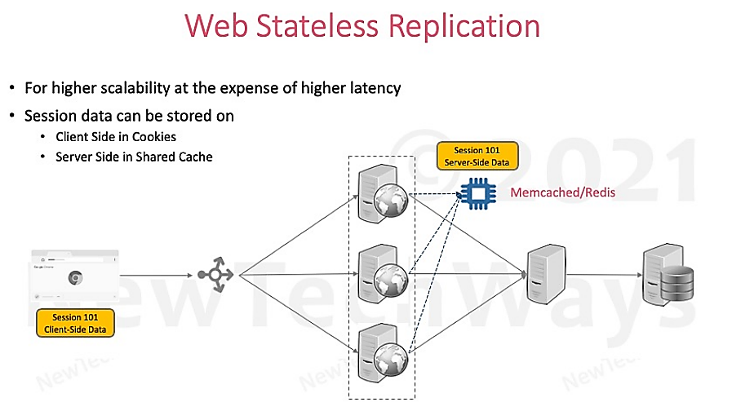

Slide 33
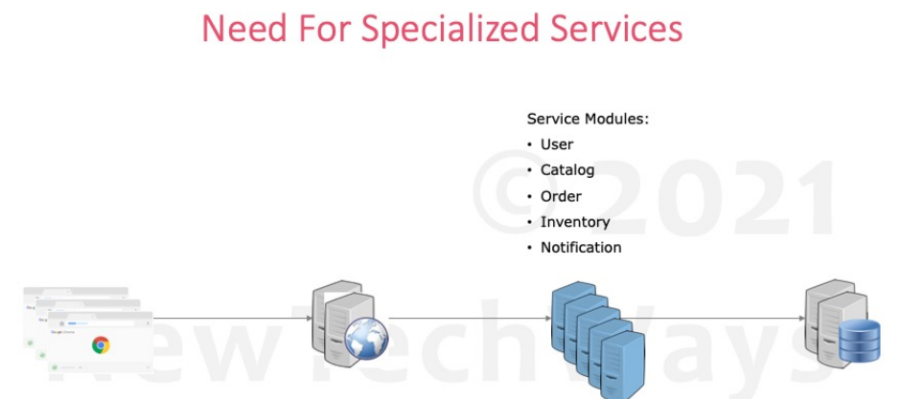

Slide 34
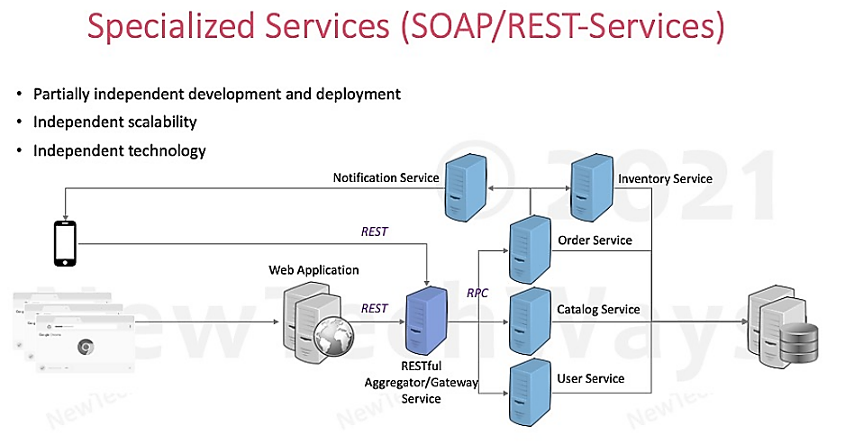

Slide 35
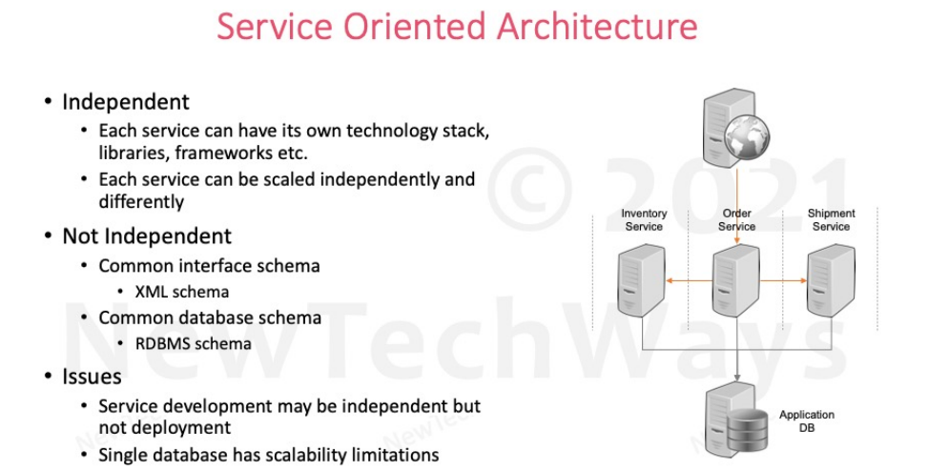

Slide 36
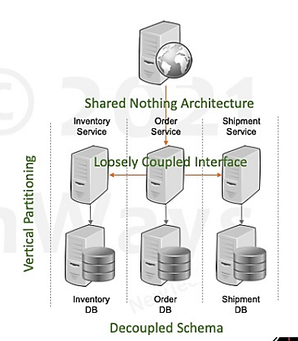
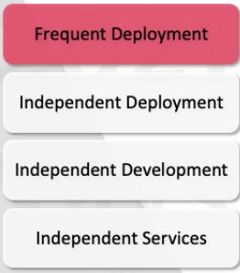
Microservices

Slide 37
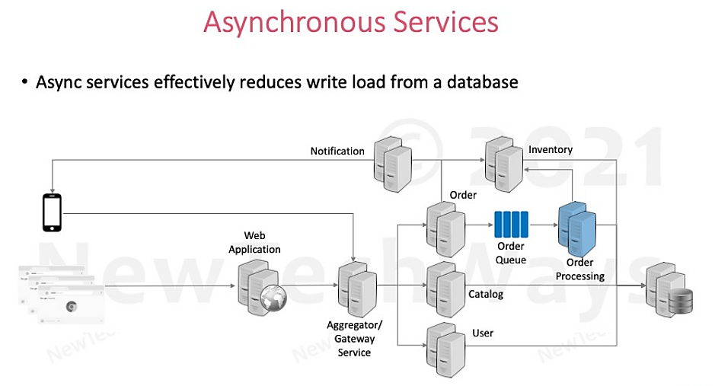

Slide 38
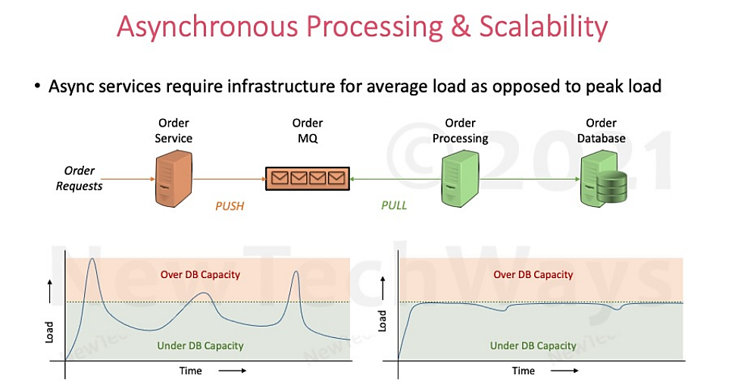

Slide 39
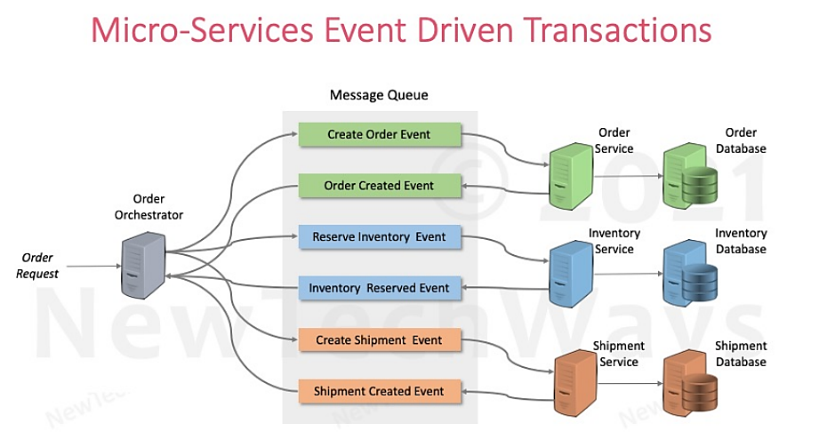

Slide 40
HAVE A GOOD DAY!

